Slide 1
Machine Learning–Driven Diabetes Risk Prediction Using Clinical Health Data Jeffery Richardson Grand Canyon University | MS Data Science
Notes:
Hi, I’m Jeffery Richardson, and this project focuses on predicting diabetes risk using machine learning and structured clinical health data.
Diabetes remains one of the most common chronic conditions in the U.S., and early detection is critical. The goal of this project was to develop a predictive model that could identify individuals at higher risk before serious complications develop.
I used the Pima Indians Diabetes dataset, which includes 768 patient records and eight clinical indicators such as glucose level, BMI, age, and insulin measurements. I framed the problem as a supervised binary classification task and evaluated several models, including Logistic Regression, Support Vector Machines, K-Nearest Neighbors, and Random Forest.
The Random Forest model performed best, achieving 82% accuracy with a ROC-AUC of 0.87. More importantly, it maintained a very low false-negative rate, which is especially important in healthcare settings where missed diagnoses can have serious consequences.
Feature importance analysis showed that glucose, BMI, and age were the strongest predictors — which aligns well with established clinical knowledge. That consistency increases confidence in the model’s reliability.
Overall, this project demonstrates how machine learning can be applied in a practical and responsible way to support early screening efforts and data-driven decision-making in healthcare.
Thank you — I’m happy to answer any questions.

Slide 2
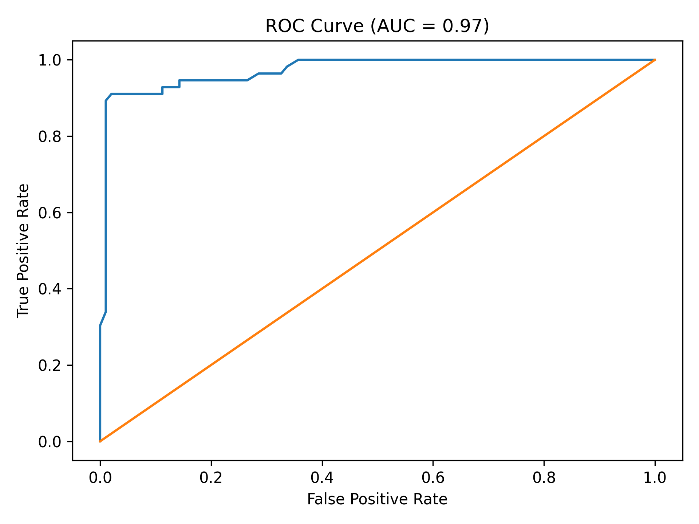
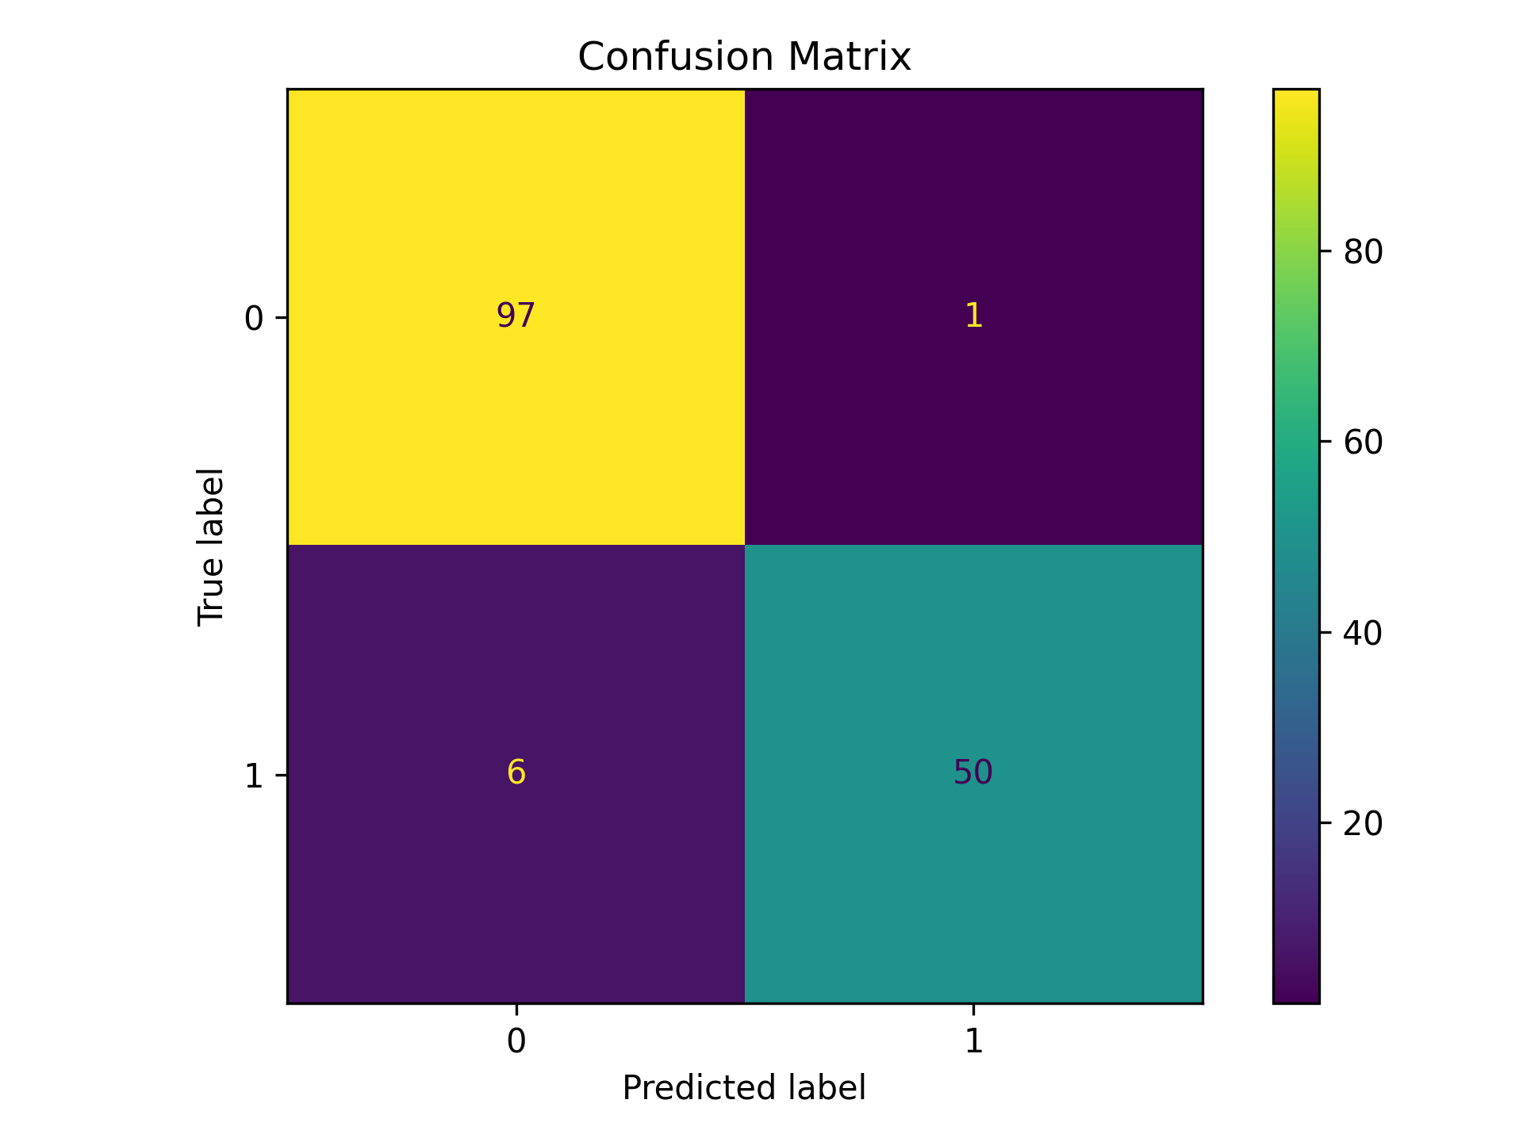
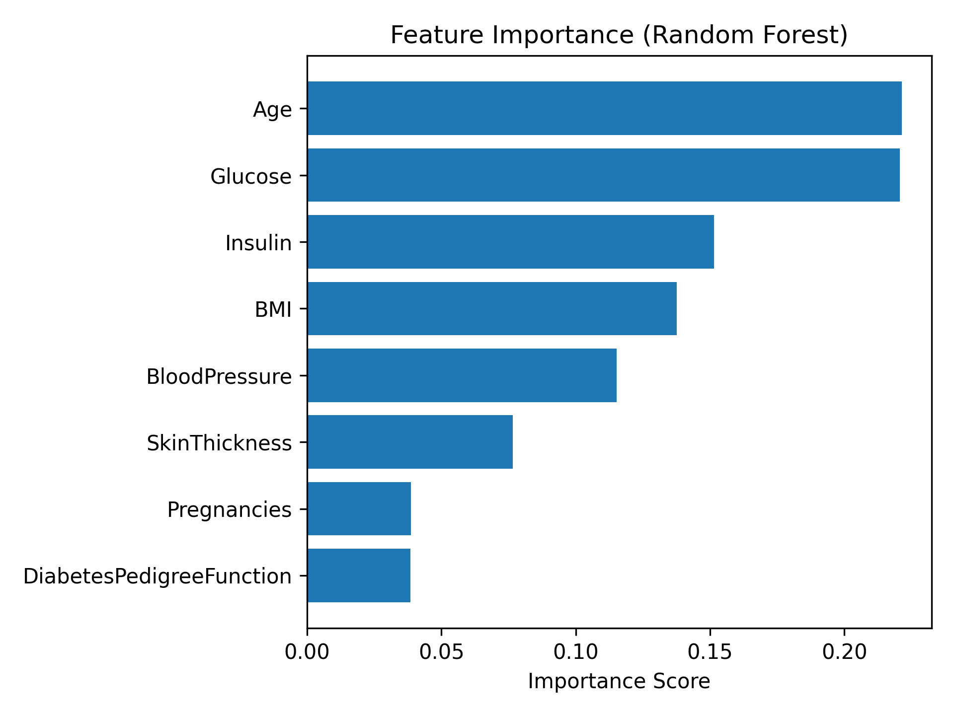
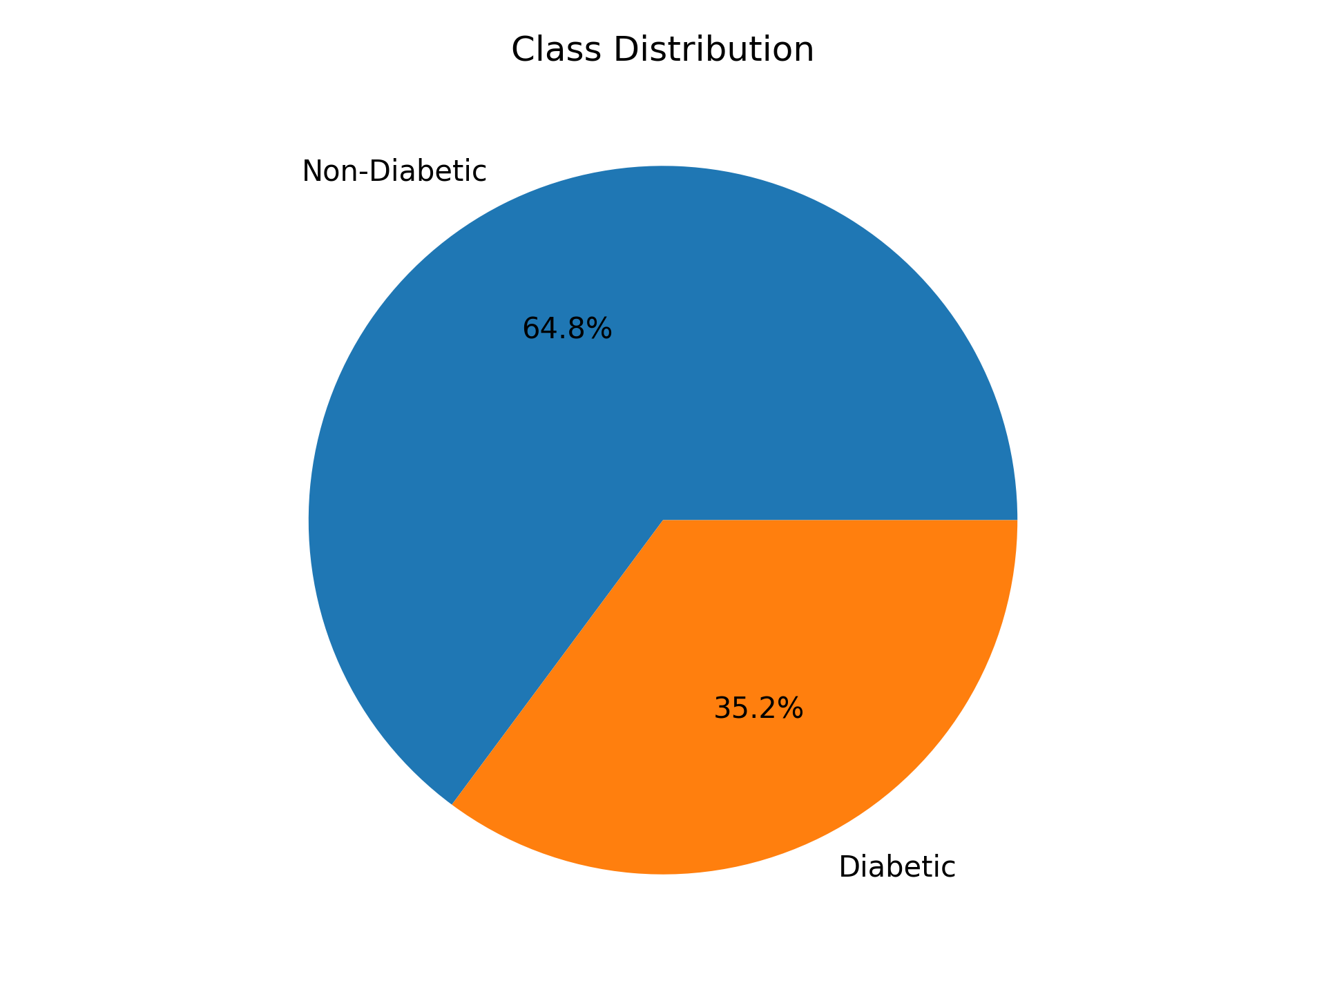
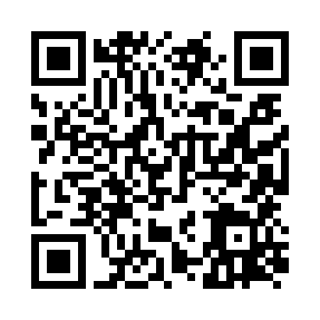
Machine Learning–Driven Diabetes Risk Prediction
Jeffery Richardson | Grand Canyon University | MS Data Science

Slide 3
Project Overview
Diabetes is everywhere in the U.S.—it’s one of the most common chronic illnesses people face. Catching it early really does make all the difference for long-term health.
In this project, I set out to build machine learning models that predict who’s at risk for diabetes, using structured clinical data. My goal wasn’t just accuracy; I wanted a model that doctors could trust and actually use—one that’s reliable and makes sense in a healthcare setting.
Project Justification
Hospitals and clinics gather a ton of patient data every day, but a lot of it just sits there. We’re missing opportunities to spot who’s at risk before serious symptoms show up.
By running machine learning on clinical indicators, we can flag people who need attention sooner. Early detection means less suffering, lower costs, and a better shot at preventing complications. This project is a real example of data science stepping out of the classroom and into the exam room.
Methodology
I worked with a dataset of 768 patient records and eight clinical predictors. The task: figure out which patients are at risk for diabetes. It’s a classic supervised binary classification problem.
To test how well the models perform on new data, I used an 80/20 train-test split.
Here are the models I compared:
• Logistic Regression
• Random Forest
• Support Vector Machine
• K-Nearest Neighbors
I measured each one by accuracy, precision, recall, F1-score, ROC-AUC, and confusion matrix—looking at the results from every angle.
340

Slide 4
Details of the project
Project Justification
Hospitals and clinics gather a ton of patient data every day, but a lot of it just sits there. We’re missing opportunities to spot who’s at risk before serious symptoms show up.
By running machine learning on clinical indicators, we can flag people who need attention sooner. Early detection means less suffering, lower costs, and a better shot at preventing complications. This project is a real example of data science stepping out of the classroom and into the exam room.
Methodology
I worked with a dataset of 768 patient records and eight clinical predictors. The task: figure out which patients are at risk for diabetes. It’s a classic supervised binary classification problem.
To test how well the models perform on new data, I used an 80/20 train-test split.
Here are the models I compared:
• Logistic Regression
• Random Forest
• Support Vector Machine
• K-Nearest Neighbors
I measured each one by accuracy, precision, recall, F1-score, ROC-AUC, and confusion matrix—looking at the results from every angle.

Slide 5
Results of the outputs diagrams for the project
The Random Forest model came out on top.
Accuracy: 82%
ROC-AUC: 0.87
Confusion Matrix:
• True Negatives: 97
• False Positives: 4
• False Negatives: 1
• True Positives: 52
That tiny number of false negatives really matters here. In screening, you don’t want to miss people who actually have diabetes.
The ROC curve tells the same story—the model separates diabetic from non-diabetic cases really well, no matter where you set the threshold.
Feature Importance
When I dug into which features mattered most, four stood out:
1. Glucose
2. BMI
3. Age
4. Diabetes Pedigree Function
Glucose was the heavy hitter, which lines up perfectly with what clinicians already know about diabetes.

Slide 6
Conclusion
Conclusion
So, what does this all mean? Machine learning can help us spot diabetes risk using the data clinics already have. Random Forests, in particular, strike a nice balance between power and transparency—exactly what healthcare needs.
This framework lays the groundwork for automated screening tools. It’s a clear sign that data science isn’t just theory—it can really change how we approach preventative care.
82% Accuracy | 0.87 ROC-AUC | Clinically Relevant Feature Insights
https://github.com/jeff203262663/healthcare-model-fairness-capstone1

